Slide 1
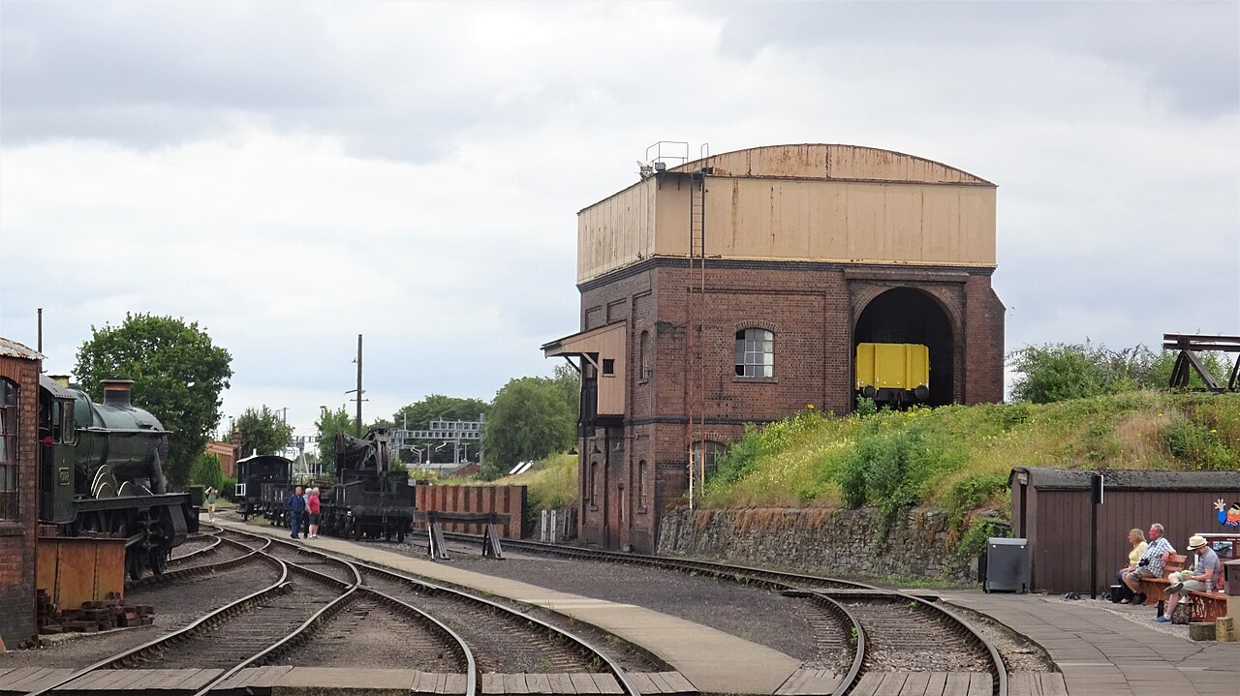
Coal, Water and Servicing
How steam locomotives eat, drink and get serviced, and how the mod plans to do it.
Rosser1954, CC BY-SA 4.0. Coal stage and water tank, Didcot.

Slide 2
How to read this guide
AGREED
Decided.
PROPOSED
Suggested, not confirmed.
PROVISIONAL
A test number that may change.
UNDECIDED
Still an open question.
BACKGROUND
A real-world fact.
Every idea carries a tag in the top-right corner.
2

Slide 3
What an engine needs
BACKGROUND
Water
2
Steam
1
Coal
4
Wheels
3
Piston
Coal heats water. Steam pushes pistons. The engine needs both coal and water.
3

Slide 4
Steam is used once
AGREED
Before
After
Empty first
One long trip
Coal
Water
Coal
Water
Steam leaves the chimney. It is not used again.
In the mod, water is usually the tighter limit.
Steam is used once and lost. So water runs out first. Coal lasts longer.
4

Slide 5
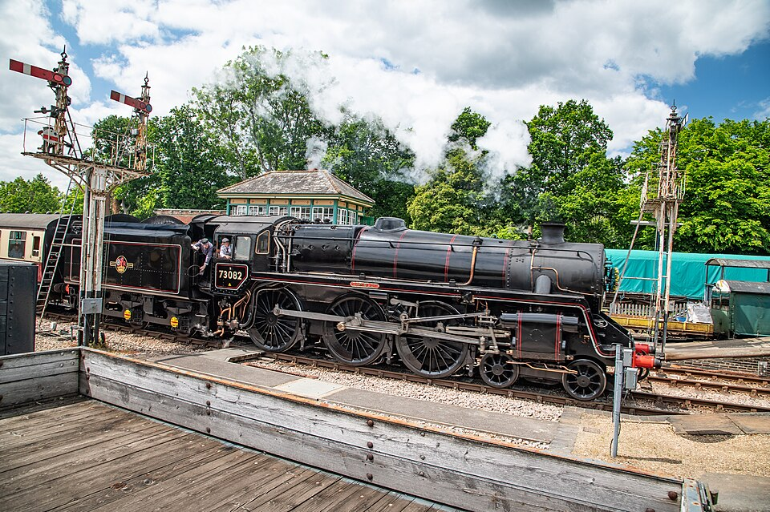
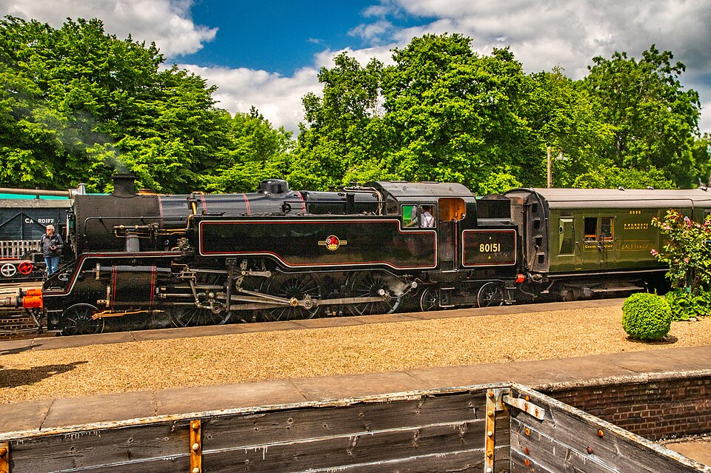
Tender or tank?
BACKGROUND
Tender engine
Tank engine
Tender: coal and water behind the cab
Side tanks: water. Bunker: coal.
www.mgaylard.co.uk, CC BY 2.0. BR Standard Class 5 No. 73082.
www.mgaylard.co.uk, CC BY 2.0. BR Standard Class 4 No. 80151.
A tender engine pulls a coal and water wagon. A tank engine carries both itself.
5

Slide 6
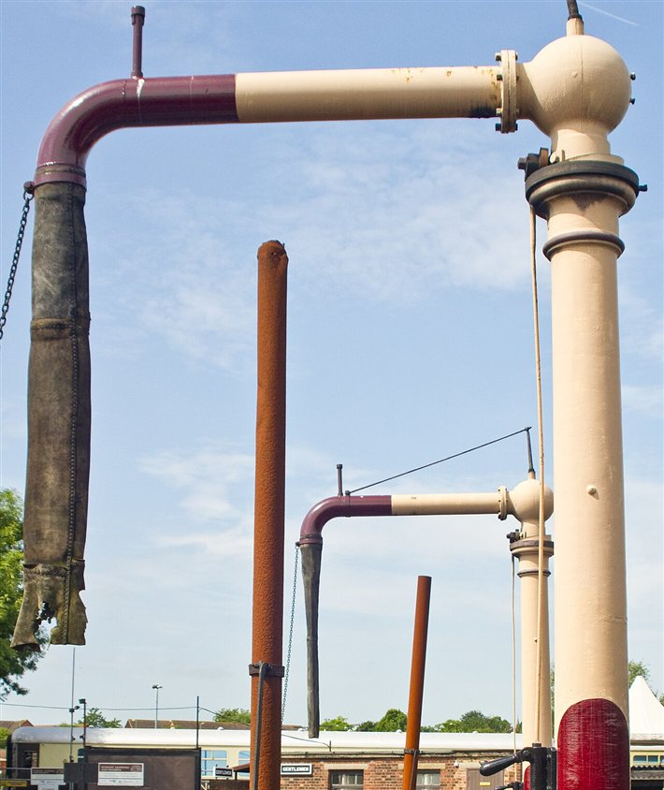
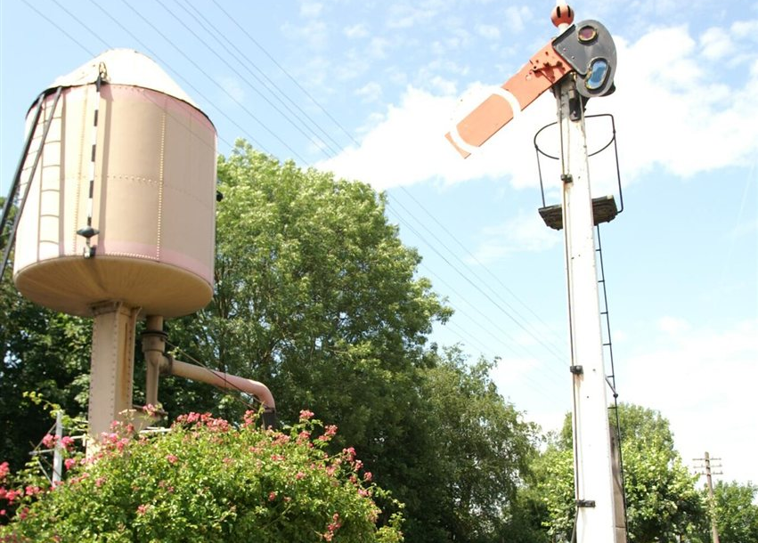
Taking on water
BACKGROUND
Arm swings over the hatch
Water tank
Gravity
Tender
David Merrett, CC BY 2.0
Barry Skeates, CC BY 2.0. A water crane, Didcot.
A water crane swings over the engine. Water flows down from a tank above.
6

Slide 7
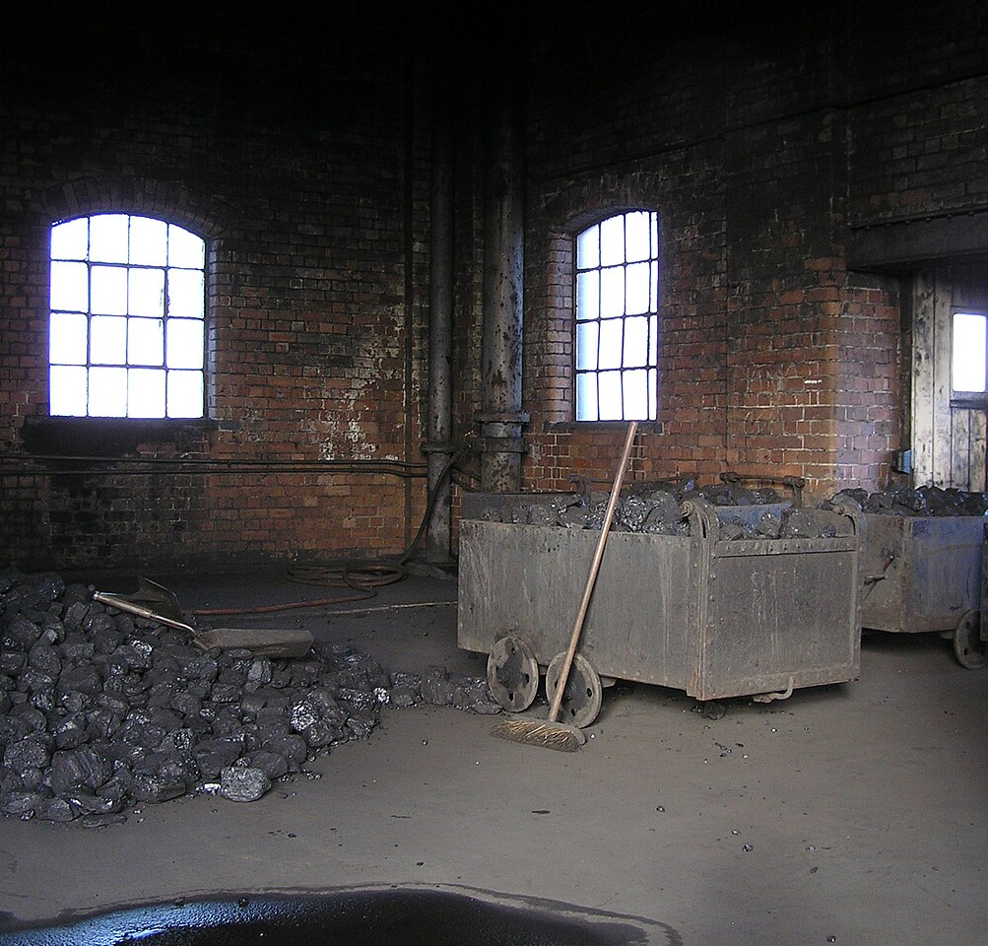
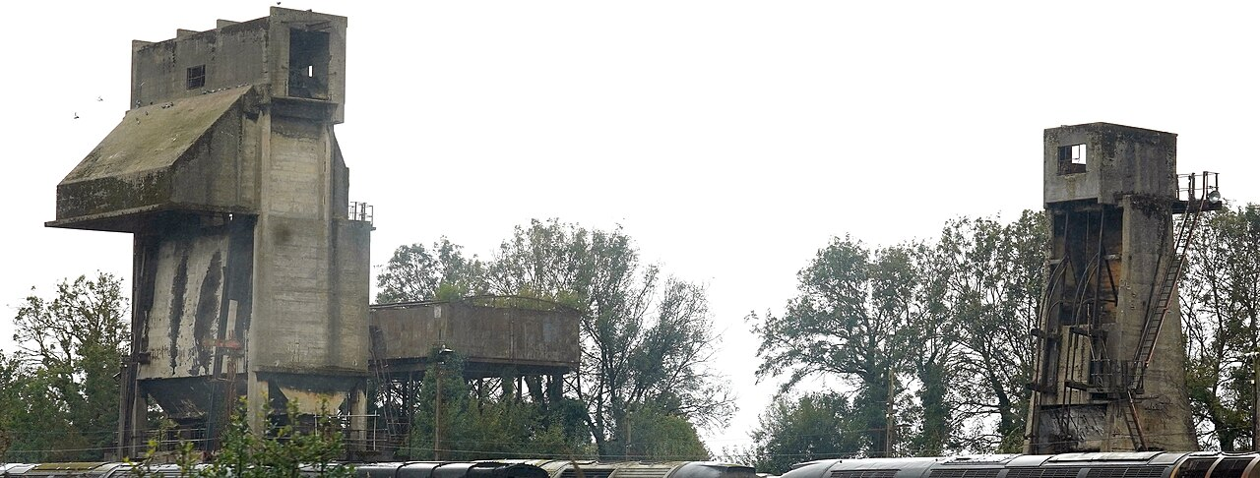
Taking on coal
BACKGROUND
Coal stage
Gravity
Coaling tower
kitmasterbloke, CC BY 4.0
Gillett's Crossing, CC BY 2.0. A coaling stage, Didcot.
Coal starts higher than the tender. A ramp or tower lets gravity fill it.
7

Slide 8
How far can an engine go?
AGREED
Range left
Coal
Water
Range estimate: Agreed direction
Range comes from real tank sizes and real use, not a distance countdown.
8

Slide 9
What makes an engine burn more
AGREED
Climbing: high
Steady: medium
Coasting: low
Shape only. Not measured.
Heavy loads, acceleration and hills use more. Coasting uses less.
9

Slide 10
Test targets for range
PROVISIONAL
Route-dependent targets
 | Water | Coal
Small | 2–3 km | 4–5 km
Medium | 4–5 km | about 7 km
Large | 6–7 km | about 10 km
PROVISIONAL
Not guaranteed distances or tank sizes.
Test targets for range per tank. They depend on the route and may change.
10

Slide 11
A better fuel
AGREED
?
Coal
Compacted Coal
Burn time
Burn time
Water saving: not established
Not to scale
Compacted Coal burns more efficiently. Water saving is not assumed.
11

Slide 12
A steam station
AGREED
Conveyor: coal in
Coal stage
Water tower
Rosser1954, CC BY-SA 4.0
Pipe: water in
Platform and cargo loading
Signal box
Vanilla station (for comparison)
Large footprint. Exact size undecided.
A steam station is big. It has a water tower, coal loading, a signal box and a platform.
12

Slide 13
Big on purpose
AGREED
Steam station
Water
Coal
Signal box
Platform
Vanilla station
Exact sizes: undecided (OQ09)
Steam technology is cheap in materials but costs land and buildings. That is the price.
13

Slide 14
Servicing takes time
AGREED
1
2
3
4
5
Approach slowly
Settle in
Long steam hiss
Coal chutes
Water arm swings
PROPOSED
6
7
8
9
Find the hatches
Tanks fill
Machinery folds away
Depart
Small top-up
Empty tanks
Rates and times: Proposed or provisional
The machinery finds each engine's hatches. Servicing takes visible time. Then it folds away.
14

Slide 15
Finding the hatches
AGREED
Water hatch
Coal point
Coal point
Water hatch
Tender engine
Tank engine
PROPOSED
Target points: water, coal, exhaust, front coupler, rear coupler, cab. Names are suggestions.
Every engine model has its own hatches. The machinery finds them.
15

Slide 16
How long does it take?
PROVISIONAL
Small top-up
PROVISIONAL
First example: 5 to 15 extra seconds
PROPOSED
Later idea: real transfer rates
Empty tanks
UNDECIDED
Rates and buffers: undecided (OQ08)
A small top-up should be quick. An empty refill takes longer.
16

Slide 17
Service points
PROPOSED
Water Tower
Coaling Stage
Steam Service Point
Full Station
PROPOSED
PROPOSED
PROPOSED
PROPOSED
Mine
Water stop
Water and coal stop
Factory
Separate coal and water stops make long routes possible. Not every stop needs a full station.
AGREED
17

Slide 18
Service stops in the timetable
PROPOSED
Timetable
PROPOSED
Mine: load
Servicing at any stop, automatically: mentioned, not chosen
1
Water Tower: water only, leave when full
2
UNDECIDED
Factory: unload
3
A timetable can include a water-only stop. The train leaves when full.
18

Slide 19
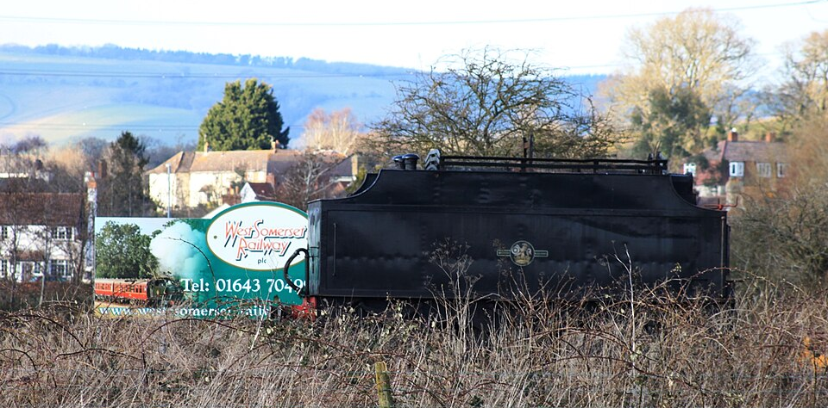
Tenders
AGREED
One vehicle
PROPOSED
Auxiliary tender: a separate wagon
Water only
Coal and water
Carries no freight
Adds weight
A real tender, for illustration. Geof Sheppard, CC BY-SA 4.0.
A normal tender belongs to the engine. An auxiliary tender is an extra wagon: more range, less pulling power.
19

Slide 20
Who gains from a tender?
AGREED
Small
Medium
Large
Extra weight worsens its main weakness
Attractive on longer work
For especially long journeys
Which types at launch: undecided (OQ10).
Small can take one, but the weight hurts. Medium gains most. Large uses one for very long trips.
20

Slide 21
Four ways to go further
AGREED
Too far
Auxiliary tender
Water stop
Service point
Bigger engine
Add a tender. Add a water stop. Build a service point. Or pick a bigger engine.
21

Slide 22
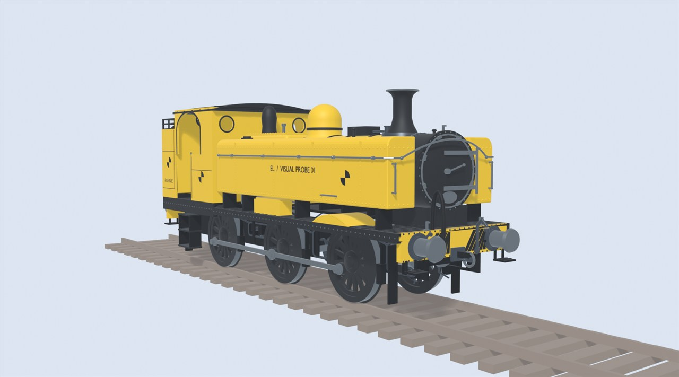
Where this stands
PROVISIONAL
Plans can change.
Early test model, not final art.
Test engine on the game's rails
Under way
Coal and water
Planned
Station servicing
Planned
Service points
Planned
Tenders
Planned
Coal, water and servicing are planned. They are not built yet.
22

Slide 23
Still undecided
UNDECIDED
UNDECIDED · OQ08
UNDECIDED · OQ08
UNDECIDED · OQ08
UNDECIDED · OQ09
Which fuels work?
What happens when supplies run out?
Station buffers and transfer rates
Station size and reach
UNDECIDED · OQ09
UNDECIDED · OQ10
UNDECIDED · OQ11
UNDECIDED · OQ11
Two engines at one station
Tender types and rules
Which service buildings?
Timetable controls for service stops
These questions are open. Nothing here has been chosen yet.
23

Slide 24
Image credits
Slot | Slide | Author and licence | Source link
P04 | 5 | www.mgaylard.co.uk, CC BY 2.0 | Commons
P05 | 5 | www.mgaylard.co.uk, CC BY 2.0 | Commons
P06 | 6 | Barry Skeates, CC BY 2.0 | Commons
P07 | 6 | David Merrett, CC BY 2.0 | Commons
P08 | 7 | Gillett's Crossing, CC BY 2.0 | Commons
P09 | 7 | kitmasterbloke, CC BY 4.0 | Commons
P17 | 1, 12 | Rosser1954, CC BY-SA 4.0 | Commons
P18 | 19 | Geof Sheppard, CC BY-SA 4.0 | Commons
R01 | 22 | Early Locomotion project (test model, not final art). | Project render
CC BY-SA photos are shown unmodified except for resizing.
Photographs come from Wikimedia Commons under Creative Commons licences.
24

